Slide 1
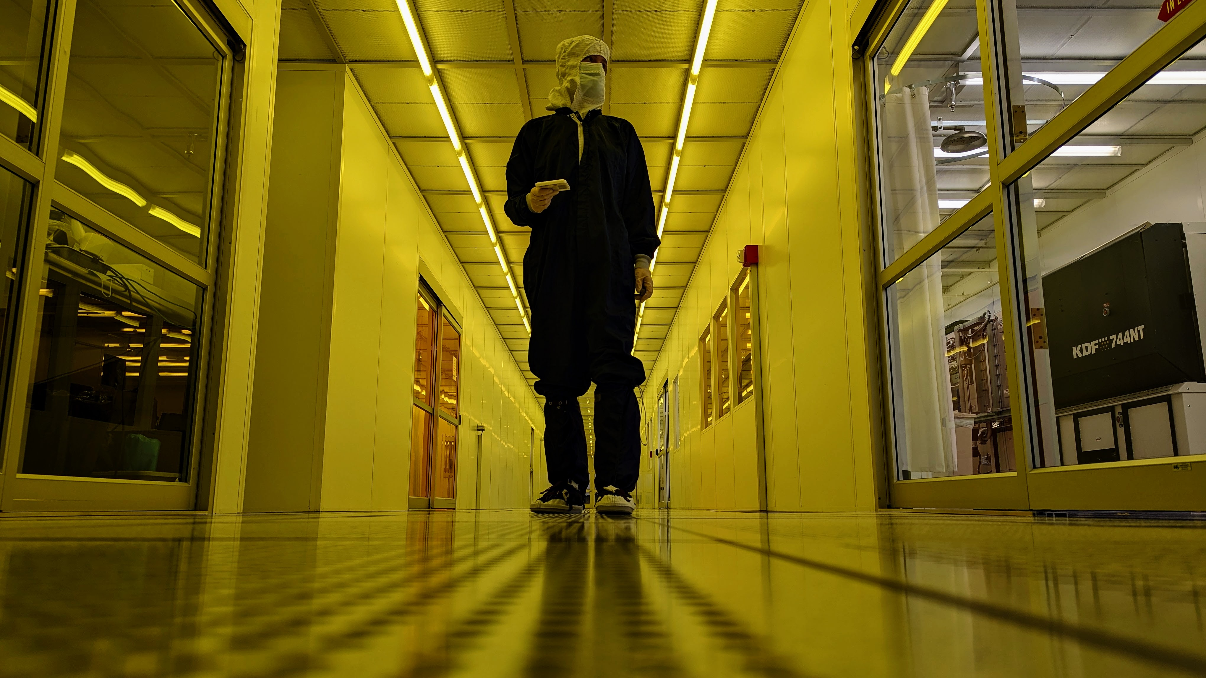

Perovskite Solar Cells in Space
Erin Burgard, Rolston Lab, Arizona Space Grant Statewide Student Research Symposium 2024

Slide 2
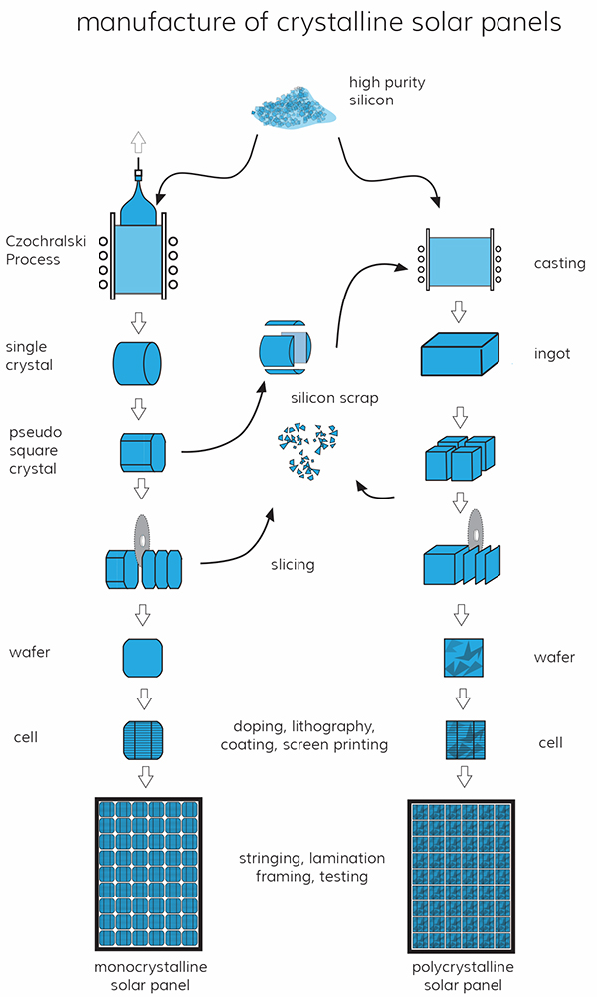
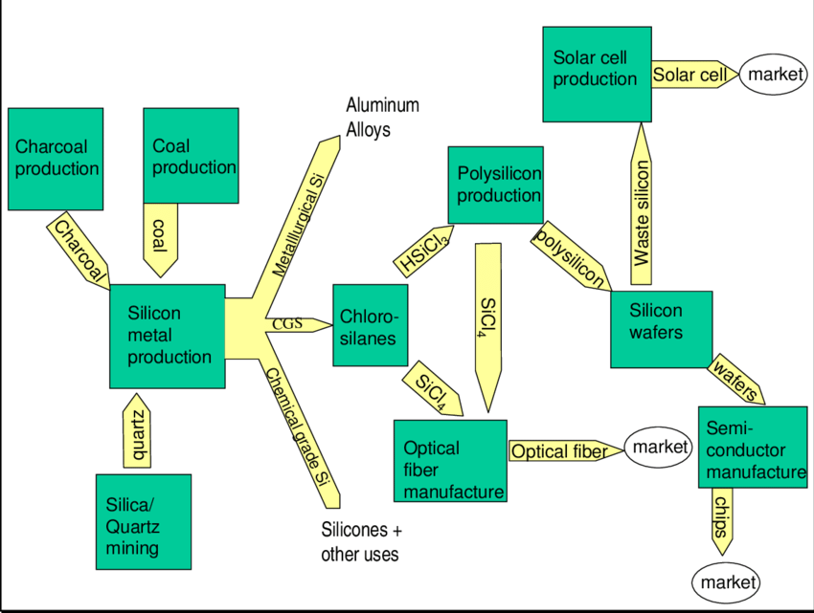

EXPENSIVE AND HARMFUL SILICON PRODUCTION
99.9999% pure silicon
2000C
Hydrochloric acid
Costly facility
Notes:
Factory to mine silica, other factory to metallurgical grade 99.99% then make it semidconductor grade, then another factory
The US has zero of these capabilities, unethical labor concerns

Slide 3
Perovskites vs. Other Solar Cells
Must meet 20-year lifetime market criterion
Needs development in:
  Device stability
  Scalability
  What makes perovskite degrade?
  Exposure to:
  Heat
  Moisture

Slide 4
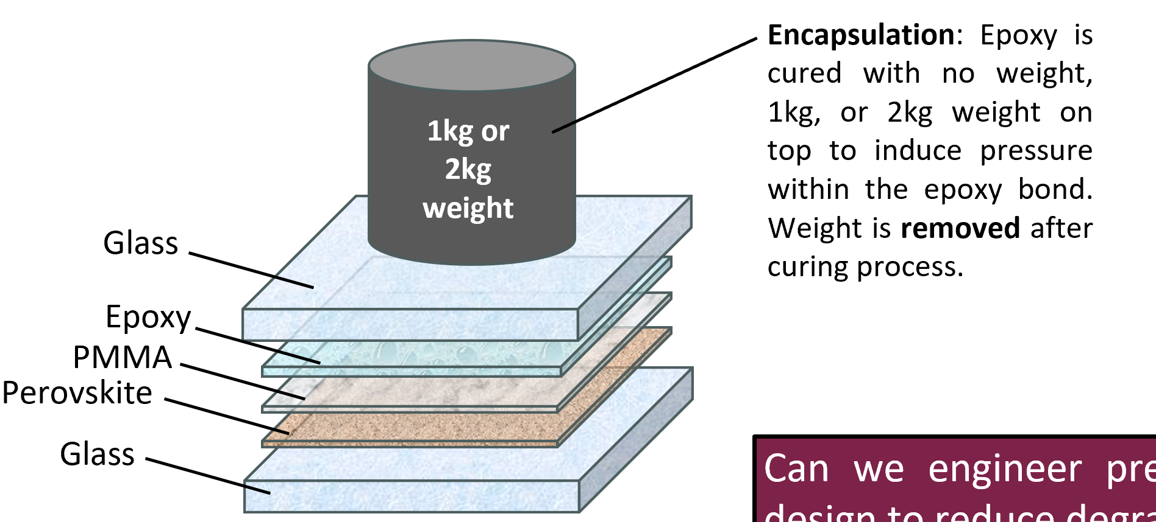

Slide 5

DETERMINE IF LOW PRESSURE CAN INDUCE STABILITY AND DECREASE DEGRADATION
2. INVESTIGATE WEIGHTED EPOXY ENCAPSULATION
Notes:
(σ > 0 is defined as tensile and σ < 0 is defined as compressive)
Film under tensile stress will try to contract, bowing the substrate in the process such that the film is on the concave side. If the film is under compressive stress, it will try to expand bowing the substrate such that film is on the convex side

Slide 6
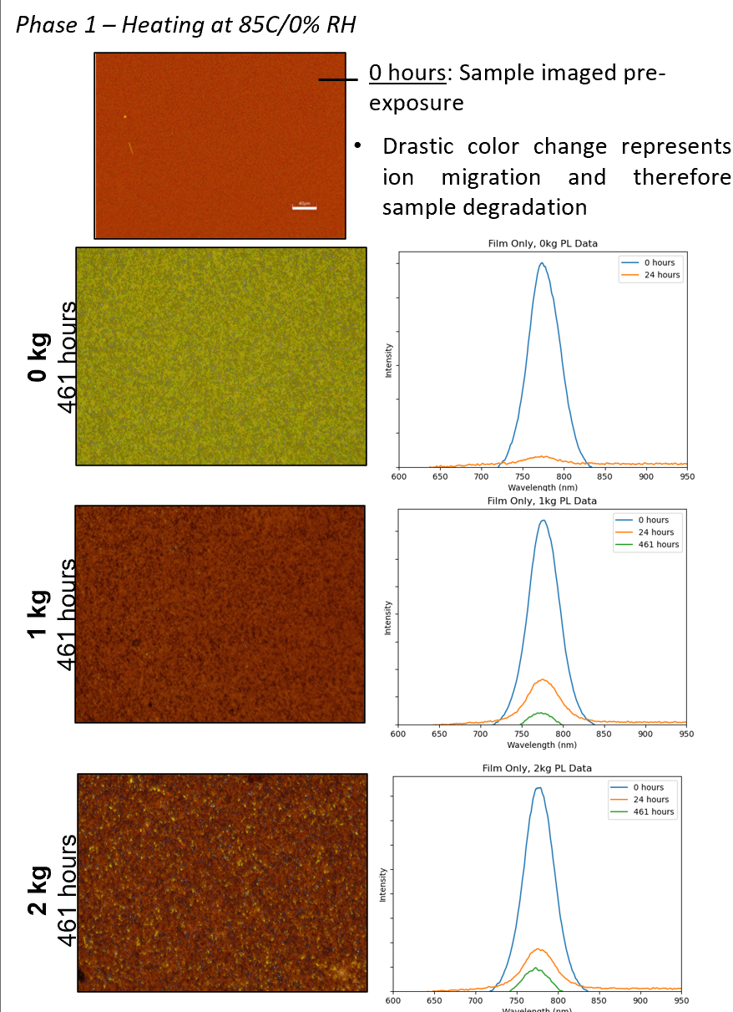
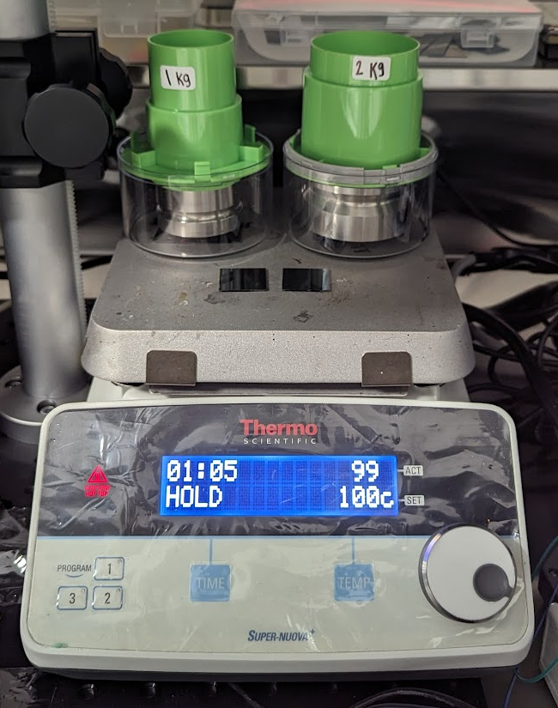
DETERMINE IF LOW PRESSURE CAN INDUCE STABILITY AND DECREASE DEGRADATION
PRELIMINARY TEST
Notes:
The benefit of doing our system is much more in-situ, faster, cheaper.. Laser is a bulky system, ours is portable and good w time, you can take points every seconds, laser is limited by laser moving around and need big samples
Es - Young’s modulus
Vs - Poisson’s ratio
ts - thickness of the glass substrate
tf - thickness of the perovskite film, and
δ - cantilever displacement from the detector at length L

Slide 7
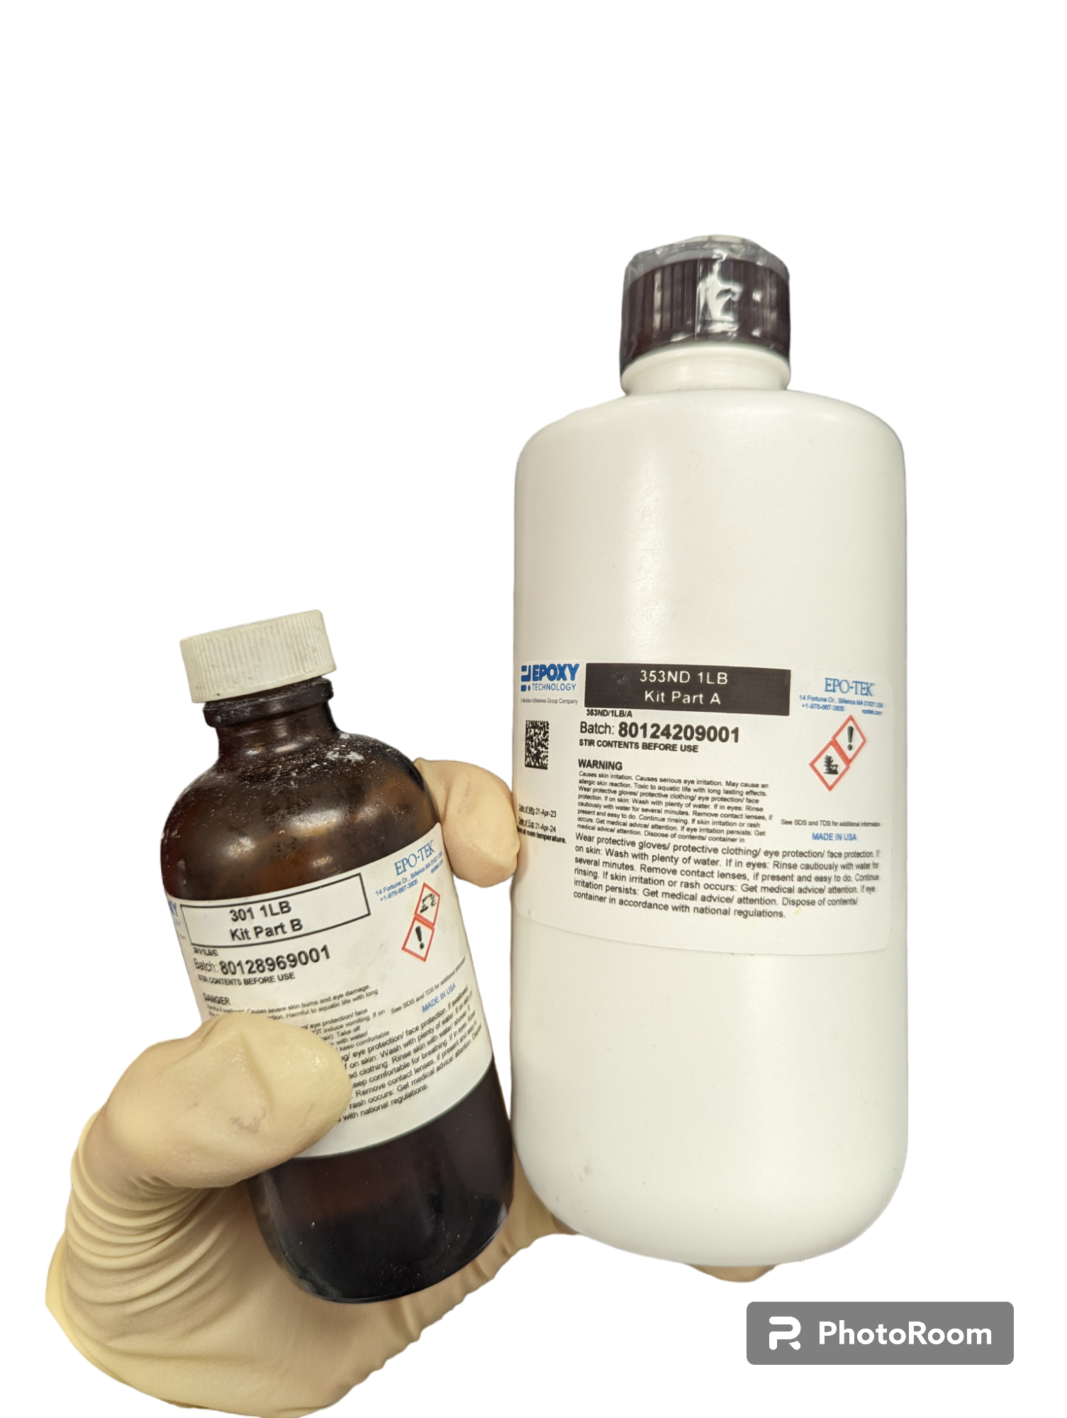
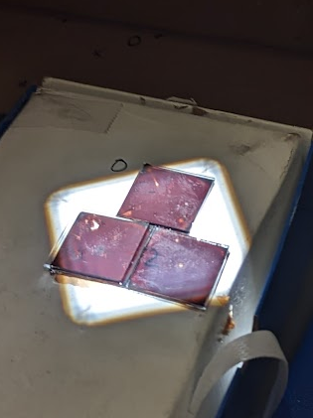
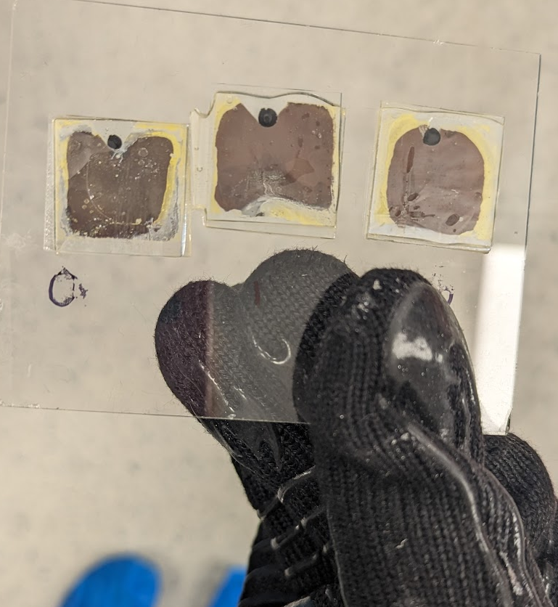



2. INVESTIGATE WEIGHTED EPOXY ENCAPSULATION
1kg or 2kg weight
Notes:
(σ > 0 is defined as tensile and σ < 0 is defined as compressive)
Film under tensile stress will try to contract, bowing the substrate in the process such that the film is on the concave side. If the film is under compressive stress, it will try to expand bowing the substrate such that film is on the convex side
Be clear that I would be clear to show how the setup has 2 samples, one which is illuminated and one which is a control that stays in the dark (or so we thought haha!)

Slide 8
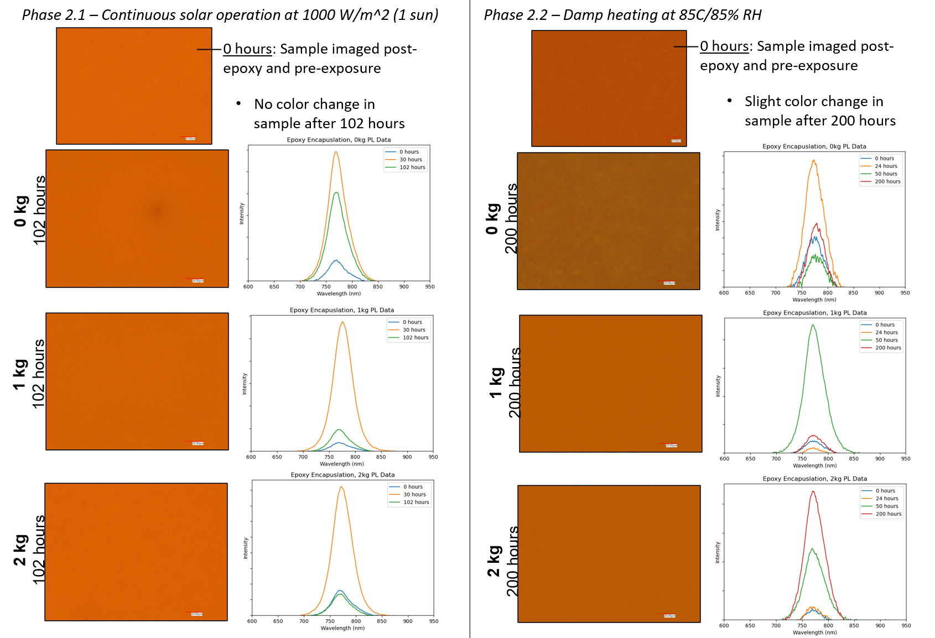

Slide 9
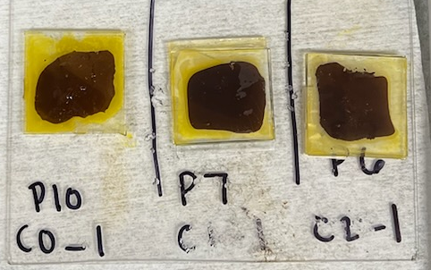
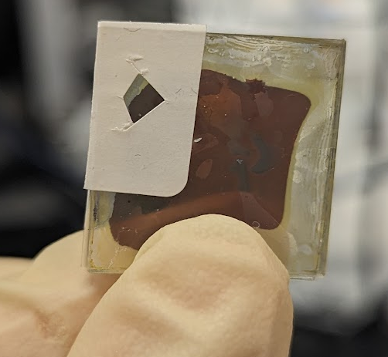
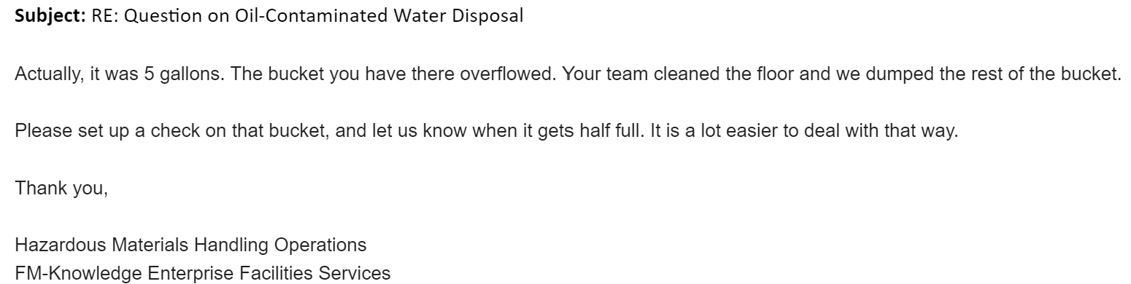
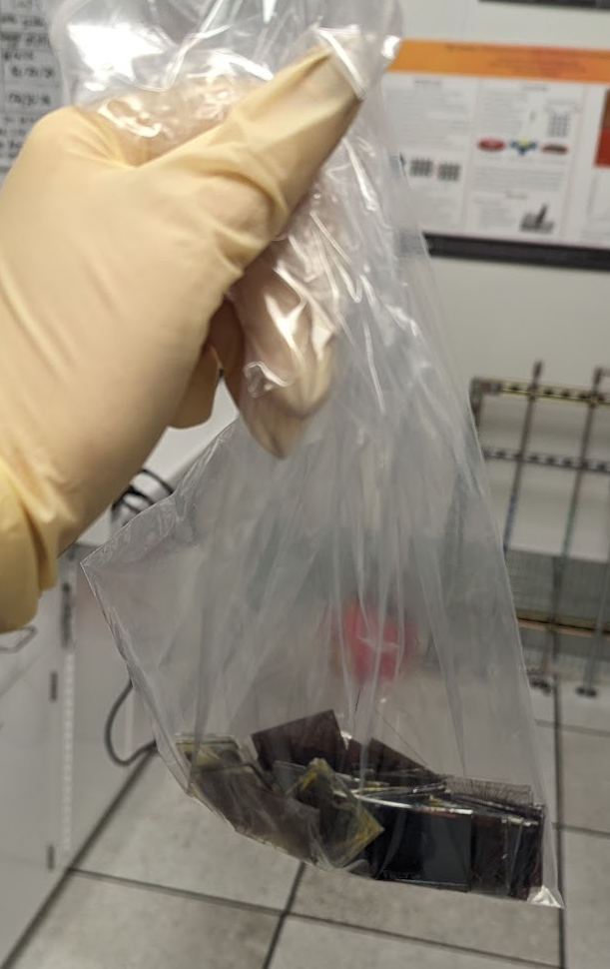
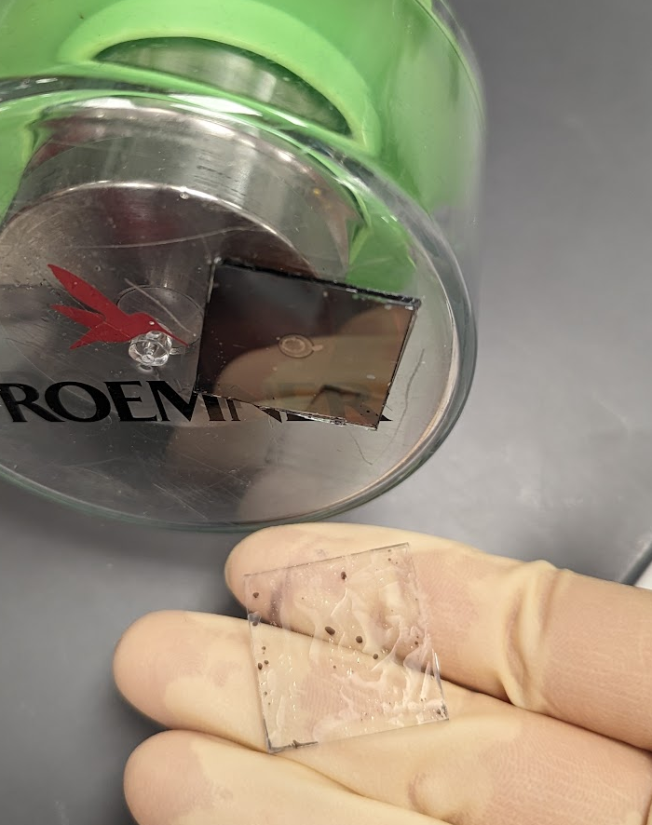
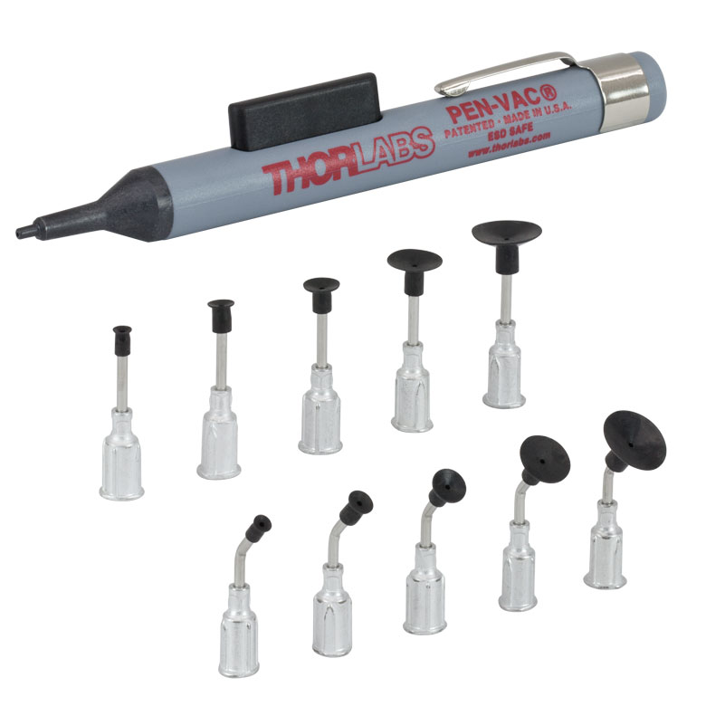
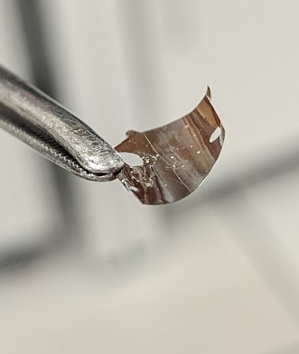
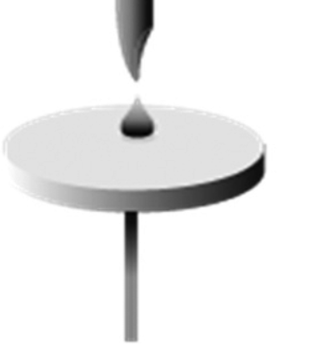
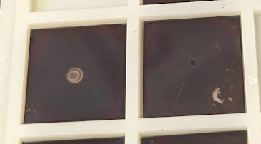
LEARNING ALONG THE WAY
Notes:
(σ > 0 is defined as tensile and σ < 0 is defined as compressive)
Film under tensile stress will try to contract, bowing the substrate in the process such that the film is on the concave side. If the film is under compressive stress, it will try to expand bowing the substrate such that film is on the convex side
Be clear that I would be clear to show how the setup has 2 samples, one which is illuminated and one which is a control that stays in the dark (or so we thought haha!)

Slide 10
CONCLUSIONS:
Low pressure on perovskite solar cells induces stability and decreases degradation
This low pressure may be achieved by weighted epoxy encapsulation
Future Work
Investigating flexible substrates
Repeat trials
Publishing results
Notes:
These are particularly sensitive to stress

Slide 11
